Slide 1
Learning Outcomes
Understand your role in the business world
Understand the basics of project management
Learn to work in Teams
Create a plan

Slide 2
Needs-driven solutions
We don’t create solutions for problems that don’t exist
vs.
research, academia, curiosity, hobby…
We do create solutions out of need
The client/boss etc. will identify the need
Sometimes they don’t articulate it well
Start with a simple statement, and go deeper
Don’t solutionize right off the bat!

Slide 3
Project Management-the problem
Understand the problem:
“What is it you need?”
“I want you to build a web server to…”
“No what is it you need?”
“Oh I need to communicate covid-19 progression.”
“Got it, why, to whom….”
Always asking “why?” helps simplify the problem to its basics

Slide 4
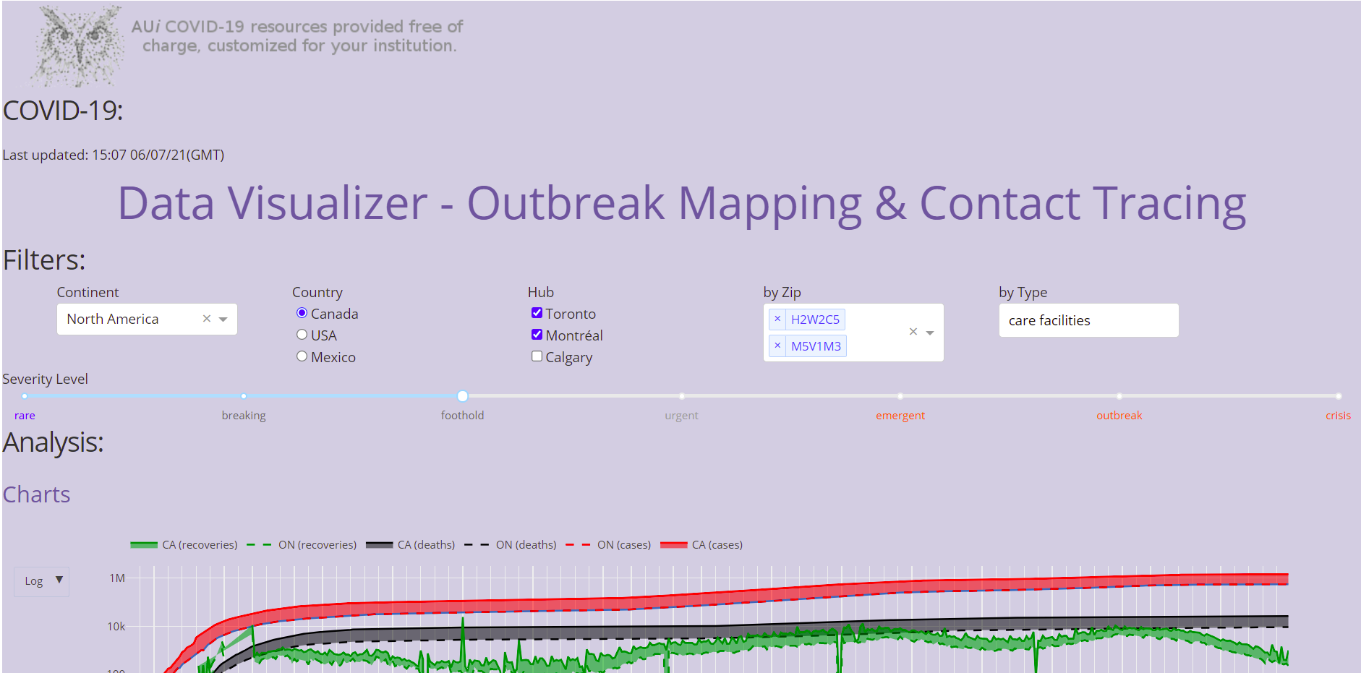
What you will be doing:

Slide 5
Project Management-the parameters
What are the constraints?
$
Time
Working hours, labour force…
What are the regulations
What are the resources I have?
Students –skill sets?
Free accounts

Slide 6
Project Management-to dos
Sort out the roles/division of labour
Set out the milestones/deliverables
Set a timetable
Split up into specialties and come up with the microplans
Exact timetables and steps
Set up a tracking system
Create fail safes

Slide 7
Project Management-roles
Sort out the roles/division of labour
Identify strengths and weaknesses
Decide on organizational structure
Leadership?
Top-down vs. sideways?
Round robin?
Matrix of duties?
Decide on accountability

Slide 8
Project Management-milestones
Define benchmarks (steps/goals)
Prioritize them
Attribute resources
Time?
$?
Labour?
Set up contingency plans

Slide 9
Project Management-timetables
Define a master timetable
Break each step into smaller timelines (tasks)
Attribute labour/task ownership
Set up contingency plans
Check progress

Slide 10
Project Management-tracking system
Use SOME system
tracking
accountability
time
dependencies
blockers
sharing

Slide 11
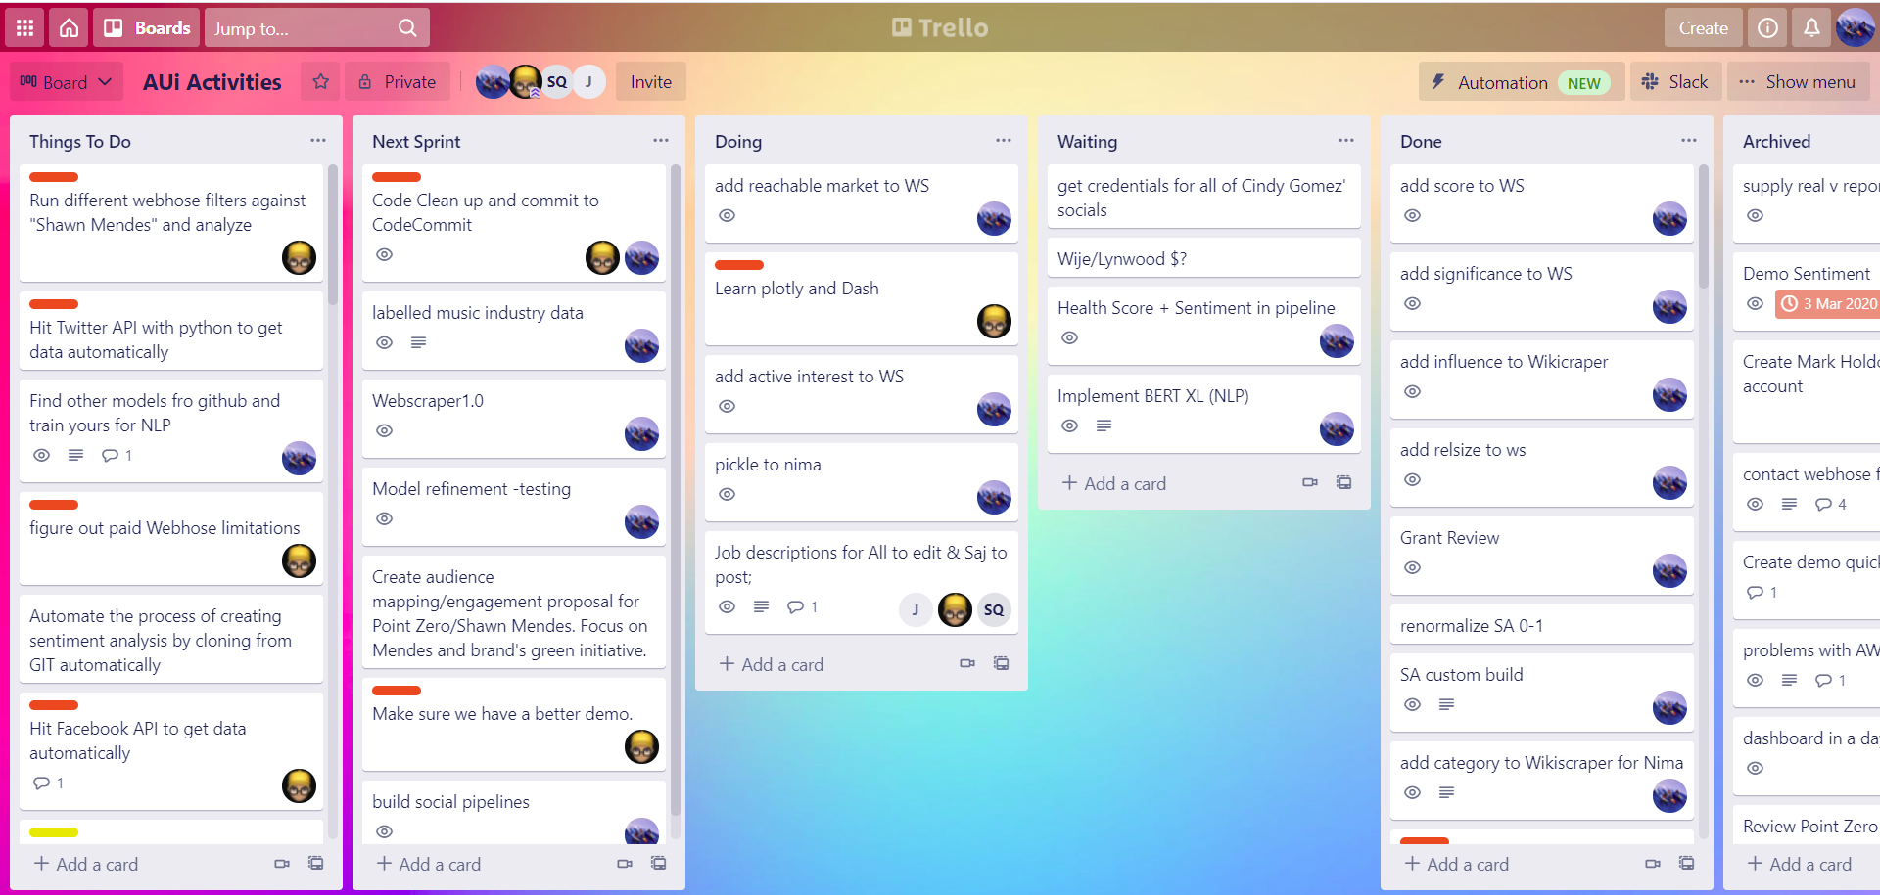
Project Management-tracking system
E.g. Gantt chart, Excel, Google Suites, Moodle, Trello:

Slide 12
Project Management-platform
DECIDE ON A PLATFORM EARLY, EARLY, EARLY!
E.g.
Google Cloud Platform, Amazon Web Services, IBM-Watson, Microsoft Azure…
Must be able to dashboard, have hosting…
Must be able to run python 3, 2,…html….
FREE? Tiers…
Support? Dedicated/paid, open source…

Slide 13
Project Management-to dos
Sort out the roles/division of labour
Set out the milestones/deliverables
Set a timetable
Split up into specialties and come up with the microplans
Exact timetables and steps
Set up a tracking system
Create fail safes
Make sure you have at least 1 coder!
Tour Moodle

